Slide 1
תכנות מונחה עצמים תרגול 1
מייל: Lashover.ariel@gmail.com
נכתב ע"י: איתי לשובר

Slide 2
נושאים להיום:
בקצרה על הקורס
יישור קו
מושג אובייקט המחלקה
שיטות והרשאות
יורשה
ממשקים
Junit
UML

Slide 3
כמה מילים על הקורס:
מה אתם מקבלים מהקורס הזה?
אחד ההבדלים בין מתכנת לבין מישהו שיודע לכתוב קוד זה העקרונות שאתם תלמדו כאן.
אחד מהנושאים הנפוצים ביותר הנשאלים בראיונות עבודה.
תיק עבודות בגיטהאב שלכם.
למה מצפים ממכם?
יושר.(תהיה בדיקת העתקות)
להשקיע במטלות.
להבין את התאוריה של מה שאתם עושים.
ללמוד לחפש מידע.
איפה ניתן לראות את החומרים של ההרצאה והתרגול ואיך עושים את זה ?
כל הקודים נמצאים ב github

Slide 4

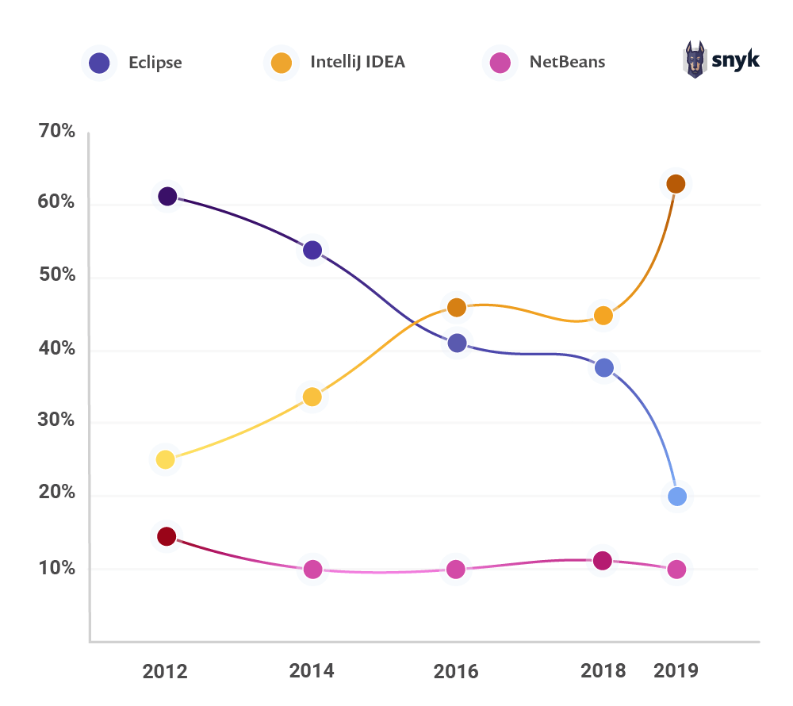

Slide 5
Google is your best friend from now !
How to syso in intellij ????
Answer

Slide 6
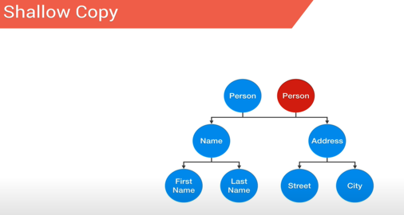
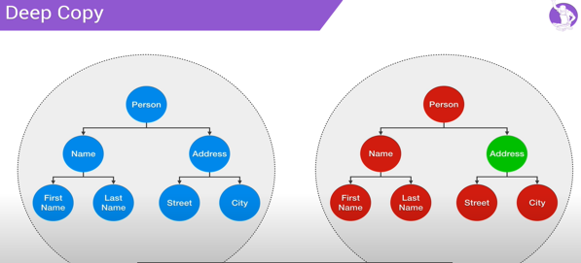
יישור קו העתקה עמוקה (deep copy)
https://www.youtube.com/watch?v=QaCYMgyprtc

Slide 7
יישור קו המושג גנרי
תכנות גנרי - הוא סגנון פיתוח תוכנה בו אלגוריתמים נכתבים במונחים של טיפוסים שיוגדרו בהמשך, וסוג הטיפוס יוגדר על פי הצורך ואז יתבצע שימוש באלגוריתם עבור הטיפוס המסוים שנקבע. (ויקיפדיה)

Slide 8
דוגמא לפונקציה גנרית:
public class GenericMethodTest { // generic method printArray public static < E > void printArray( E[] inputArray ) { // Display array elements for(E element : inputArray) { System.out.printf("%s ", element); } System.out.println(); } public static void main(String args[]) { // Create arrays of Integer, Double and Character Integer[] intArray = { 1, 2, 3, 4, 5 }; Double[] doubleArray = { 1.1, 2.2, 3.3, 4.4 }; Character[] charArray = { 'H', 'E', 'L', 'L', 'O' }; System.out.println("Array integerArray contains:"); printArray(intArray); // pass an Integer array System.out.println("\nArray doubleArray contains:"); printArray(doubleArray); // pass a Double array System.out.println("\nArray characterArray contains:"); printArray(charArray); // pass a Character array } }

Slide 9
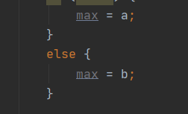
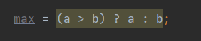
Shorten if
The value of a variable often depends on whether a particular boolean expression is or is not true and on nothing else.
For instance one common operation is setting the value of a variable to the maximum of two quantities. In Java you might write
Setting a single variable to one of two states based on a single condition is such a common use of if-else that a shortcut has been devised for it, the conditional operator, Using the conditional operator you can rewrite the above example in a single line like this:

Slide 10
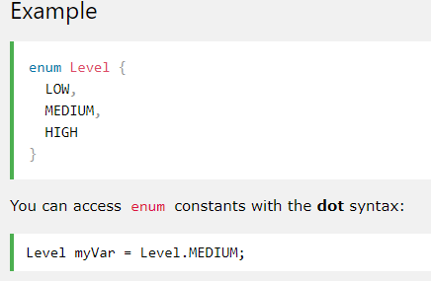
Enum
An enum is a special "class" that represents a group of constants (unchangeable variables, like final variables).
To create an enum, use the enum keyword (instead of class or interface), and separate the constants with a comma. Note that they should be in uppercase letters:

Slide 11
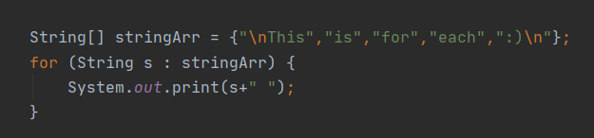
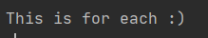
For each
Output:

Slide 12
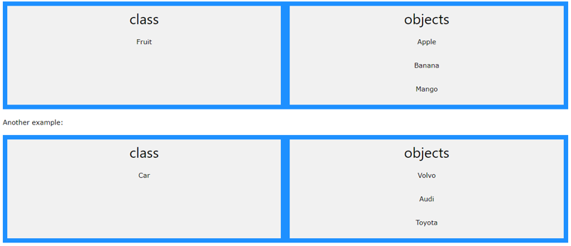
Classes
Java - What are Classes and Objects?
Classes and objects are the two main aspects of object-oriented programming.
Look at the following illustration to see the difference between class and objects:

Slide 13
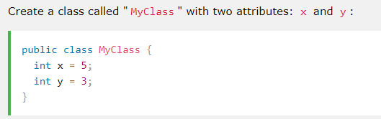
Classes Constructors
Create a Class
To create a class, use the keyword class:

Slide 14
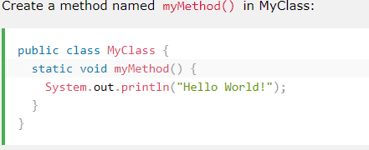
Classes methods
Java class methods:

Slide 15
Classes constructor
A constructor in Java is a special method that is used to initialize objects. The constructor is called when an object of a class is created. It can be used to set initial values for object attributes:

Slide 16
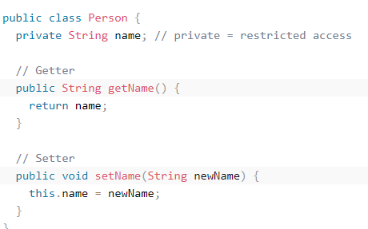
Classes Encapsulation
The meaning of Encapsulation, is to make sure that "sensitive" data is hidden from users. To achieve this, you must:
declare class variables/attributes as private
provide public get and set methods to access and update the value of a private variable

Slide 17
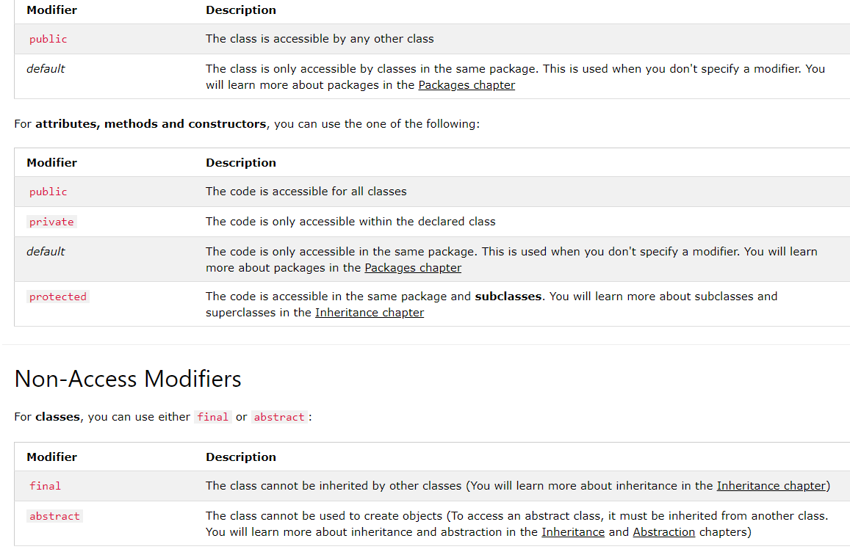
Classes Modifier

Slide 18
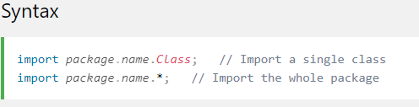
Classes Packages & API
Java Packages & API
A package in Java is used to group related classes. Think of it as a folder in a file directory. We use packages to avoid name conflicts, and to write a better maintainable code. Packages are divided into two categories:
Built-in Packages (packages from the Java API)
User-defined Packages (create your own packages)

Slide 19
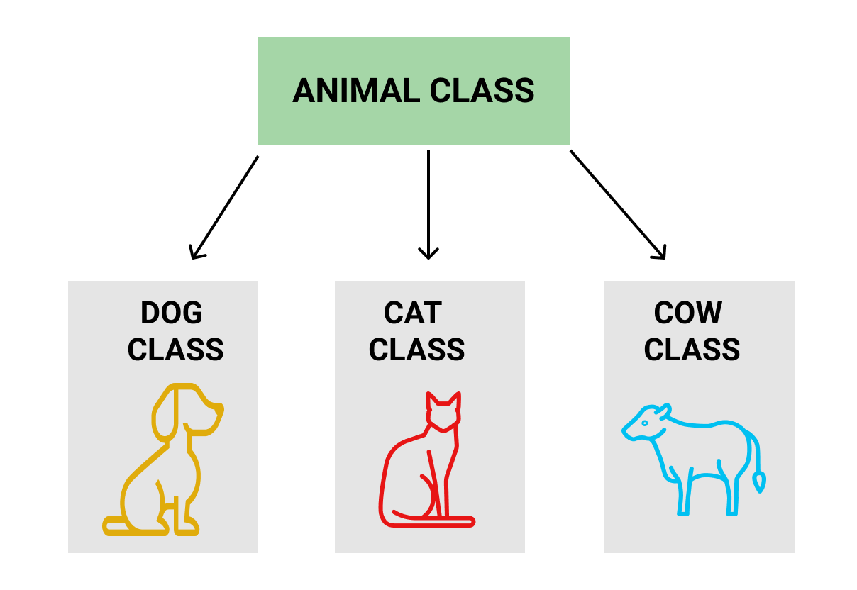
Java Inheritance (Subclass and Superclass)
subclass (child) - the class that inherits from another class
superclass (parent) - the class being inherited from

Slide 20
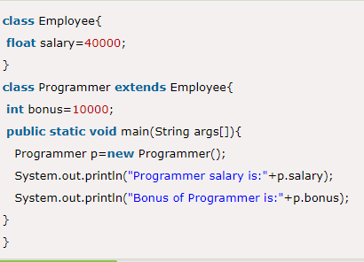
Inheritance
In Java, it is possible to inherit attributes and methods from one class to another. We group the "inheritance concept" into two categories:
subclass (child) - the class that inherits from another class
superclass (parent) - the class being inherited from
To inherit from a class, use the extends keyword.

Slide 21
Polymorphism
Java Polymorphism
Polymorphism means "many forms", and it occurs when we have many classes that are related to each other by inheritance.
Like we specified in the previous chapter; Inheritance lets us inherit attributes and methods from another class. Polymorphism uses those methods to perform different tasks. This allows us to perform a single action in different ways.

Slide 23
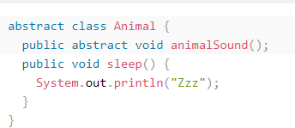
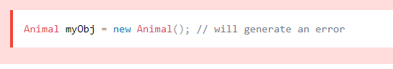
Abstraction
Abstract Classes and Methods
Data abstraction is the process of hiding certain details and showing only essential information to the user.
Abstraction can be achieved with either abstract classes or interfaces (which you will learn more about in the next chapter).
The abstract :
keyword is a non-access modifier, used for classes and methods
Abstract class: is a restricted class that cannot be used to create objects (to access it, it must be inherited from another class).
Abstract method: can only be used in an abstract class, and it does not have a body. The body is provided by the subclass (inherited from).
An abstract class can have both abstract and regular methods:

Slide 24
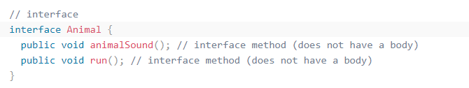
Interfaces
Another way to achieve abstraction in Java, is with interfaces.
An interface is a completely "abstract class" that is used to group related methods with empty bodies:

Slide 25
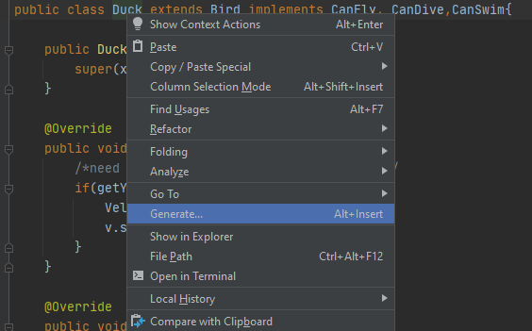
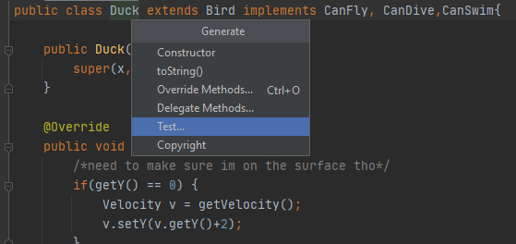
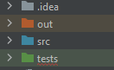
Juint
JUNIT 5 זו היא ספרייה שבעזרתה מכינים טסטים שיבדקו את קטעי הקוד שכתבנו.
האידיאל הוא שנכתוב את הטסטים לפני שבכלל נתחיל לכתוב את הקוד עצמו.
את הקבצים של הטסטים נרצה למקם בתקיה נפרדת ששמה יהיה tests (השם לא קריטי) .

Slide 26
JUNIT syntax
המתודות שנכתוב במחלקת טסט יהיו בעצם טסטים. כל מתודה שמסומנת מעליה האנוטציה @Test היא מתודה של טסט.
ישנם מלא אנוטציות שאפשר להוסיף למתודות במחלקה, ויש לזכור שהמחלקה הזאת היא מחלקה רגילה לכל דבר, גם לה אפשר ליצור תכונות ואפילו לאתחל ולעדכן אותן בין טסט לטסט.
אנוטציות נוספות שאפשר להוסיף הן @BeforeEach @AfterEach @BeforeAll @AfterAll @Disabled @Timeout
https://junit.org/junit5/docs/current/user-guide/

Slide 27
JUNIT syntax
@Test – מייצג שהמתודה היא טסט
@AfterEach – המתודה תרוץ אחרי כל אחד מהטסטים
@BeforeEach – המתודה תרוץ לפני כל אחד מהטסטים
@BeforeAll – מתודה שתרוץ לפני כל הטסטים
@AfterAll - מתודה שתרוץ אחרי כל הטסטים
@Timeout – המתודה שמה זמן מקסימלי שבו הטסט יכול לרוץ ואם הוא חורג מהזמן הזה הטסט נכשל.

Slide 28
Assert class
The org.junit.Assert class provides methods to assert the program logic.
Methods of Assert class:
The common methods of Assert class are as follows:
void assertEquals(boolean expected,boolean actual): checks that two primitives/objects are equal. It is overloaded.
void assertTrue(boolean condition): checks that a condition is true.
void assertFalse(boolean condition): checks that a condition is false.
void assertNull(Object obj): checks that object is null.
void assertNotNull(Object obj): checks that object is not null.

Slide 29
uml
UML Class Notation
A class represent a concept which encapsulates state (attributes) and behavior (operations). Each attribute has a type. Each operation has a signature. The class name is the only mandatory information.
Class Name:
The name of the class appears in the first partition.
Class Attributes:
Attributes are shown in the second partition.
The attribute type is shown after the colon.
Attributes map onto member variables (data members) in code.
Class Operations (Methods):
Operations are shown in the third partition. They are services the class provides.
The return type of a method is shown after the colon at the end of the method signature.
The return type of method parameters are shown after the colon following the parameter name. Operations map onto class methods in code

Slide 30
uml
Class Visibility
The +, - and # symbols before an attribute and operation name in a class denote the visibility of the attribute and operation.
+ denotes public attributes or operations
- denotes private attributes or operations
# denotes protected attributes or operations

Slide 31
uml
Relationships between classes
UML is not just about pretty pictures. If used correctly, UML precisely conveys how code should be implemented from diagrams. If precisely interpreted, the implemented code will correctly reflect the intent of the designer. Can you describe what each of the relationships mean relative to your target programming language shown in the Figure below?
If you can't yet recognize them, no problem this section is meant to help you to understand UML class relationships. A class may be involved in one or more relationships with other classes. A relationship can be one of the following types:

